Slide 1

Record Linkage
Craig Knoblock & Jose Luis Ambite
University of Southern California
slides by Craig Knoblock

Slide 2
Introduction
Data matching: find structured data items that refer to the same real-world entity
entities may be represented by tuples, XML elements, or RDF triples, not by strings as in string matching
e.g., (David Smith, 608-245-4367, Madison WI) vs (D. M. Smith, 245-4367, Madison WI)
Data matching arises in many integration scenarios
merging multiple databases with the same schema
joining rows from sources with different schemas
matching a user query to a data item
One of the most fundamental problems in data integration
Slide from Anhai Doan, Alon Halevy, Zachary Ives

Slide 3
Problem Definition
Given two relational tables X and Y with identical schemas
assume each tuple in X and Y describes an entity (e.g., person)
We say tuple x ∈ X matches tuple y ∈ Y if they refer to the same real-world entity
(x,y) is called a match
Goal: find all matches between X and Y
Slide from Anhai Doan, Alon Halevy, Zachary Ives

Slide 4
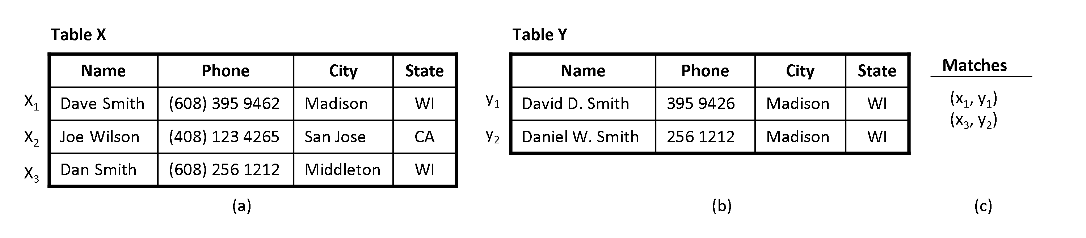
Example
Other variations
Tables X and Y have different schemas
Match tuples within a single table X
The data is not relational, but XML or RDF
These are not considered here
Slide from Anhai Doan, Alon Halevy, Zachary Ives

Slide 5
Why is This Different than String Matching?
We could treat each tuple as a string by concatenating the fields, then apply string matching techniques
But doing so makes it hard to apply sophisticated techniques and domain-specific knowledge
E.g., consider matching tuples that describe persons
suppose we know that in this domain two tuples match if the names and phone match exactly
this knowledge is hard to encode if we use string matching
so it is better to keep the fields apart
Slide from Anhai Doan, Alon Halevy, Zachary Ives

Slide 6
Challenges
How to scale up to large data sets
Cannot compare every possible pair of records
How to match accurately?
Difficult due to variations in formatting conventions, use of abbreviations, different naming conventions, omissions, nicknames, and errors
Several commonly used approaches: rule-based, learning-based, clustering
slide by Craig Knoblock

Slide 7
General Approach to Record Linkage
Identification of candidate pairs (blocking)
Comparing all possible record pairs would be computationally wasteful
Compute Field Similarity
String similarity between individual fields is computed
Compute Record Similarity
Field similarities are combined into a total record similarity estimate
slide by Craig Knoblock

Slide 8
Overview
table A
table B
A ₁
B ₁
…
…
A _{n}
B _{n}
Map attribute(s) from one datasource to attribute(s) from the other datasource.
define schema alignment
Find the most likely candidate pairs
Blocking
Using one of the various string matching algorithms
Field Similarity
Using one of the approaches to data matching
Record Similarity
slide by Craig Knoblock

Slide 9
Outline
Blocking
Rule-based blocking
Learning-based blocking
Automatic blocking
Record Linkage
Rule-based matching
Learning-based matching
Automatic matching
slide by Craig Knoblock

Slide 10
Outline
Blocking
Rule-based blocking
Learning-based blocking
Automatic blocking
Record Linkage
Rule-based matching
Learning-based matching
Automatic matching
slide by Craig Knoblock

Slide 11
Record Linkage – Finding Matches
Census Data
First Name | Last Name | Phone | Zip
Matt | Michelson | 555-5555 | 12345
Jane | Jones | 555-1111 | 12345
Joe | Smith | 555-0011 | 12345
A.I. Researchers
match
First Name | Last Name | Phone | Zip
Matthew | Michelson | 555-5555 | 12345
Jim | Jones | 555-1111 | 12345
Joe | Smeth | 555-0011 | 12345
match
Slide by Matthew Michelson

Slide 12
Record Linkage – Finding Matches
Can’t compare all records!
Just 5,000 to 5,000 → 25,000,000 comparisons!
At 0.01s/comparison → 250,000 s → ~3 days!
Need to use a subset of comparisons
“Candidate matches”
Want to cover true matches
Want to throw away non-matches
Slide by Matthew Michelson

Slide 13
Blocking – Generating Candidates
(method, attribute)
(token, last name) AND (1st letter, first name) = block-key
First Name | Last Name
Matt | Michelson
Jane | Jones
First Name | Last Name
Matthew | Michelson
Jim | Jones
(token, zip)
First Name | Last Name | Zip
Matt | Michelson | 12345
Matt | Michelson | 12345
Matt | Michelson | 12345
First Name | Last Name | Zip
Matthew | Michelson | 12345
Jim | Jones | 12345
Joe | Smeth | 12345
Slide by Matthew Michelson

Slide 14
Blocking – Generating Candidates
(method, attribute)
(token, last name) AND (1st letter, first name) = block-key
First Name | Last Name
Matt | Michelson
Matthew | Michelson
First Name | Last Name
Matt | Michelson
Jane | Jones
Matthew | Michelson
Jim | Jones
First Name | Last Name
Jane | Jones
Jim | Jones
Slide from Matthew Michelson

Slide 15
Blocking - Intuition
Census Data
First Name | Last Name | Zip
Matt | Michelson | 12345
Jane | Jones | 12345
Joe | Smith | 12345
1 Block of 12345 Zips
Zip = ‘12345’
Group by “Block-key”
Compare entities within each block
→ Reduce number of checks!
Slide by Matthew Michelson and Jose Luis Ambite

Slide 16
Blocking – Multi-pass (Hernandez & Stolfo, 1998)
Sort neighborhoods on block keys
Multiple independent runs using keys
runs capture different match candidates
Example:
1st → (token, last name)
2nd → (token, first name) & (token, phone)
Slide by Matthew Michelson

Slide 17
Blocking – Multi-pass
Terminology:
Each pass is a “conjunction”
(token, first) AND (token, phone)
Combine passes to form “disjunction”
[(token, last)] OR [(token, first) AND (token, phone)]
Disjunctive Normal Form rules
form “Blocking Schemes”
Slide by Matthew Michelson

Slide 18
Blocking Effectiveness
Determined by rules
Determined by choices for attributes and methods
(token, zip) captures all matches, but all pairs too
(token, first) AND (token, phone) gets half the matches, and only 1 candidate generated
Which is better? Why?
How to quantify??
Slide by Matthew Michelson

Slide 19
Blocking Effectiveness
Reduction Ratio (RR) = 1 – ||C|| / (||S|| *|| T||)
S,T are data sets; C is the set of candidates
Pairs Completeness (PC) [Recall] = S_{m} / N_{m}
S_{m} = # true matches in candidates,
N_{m} = # true matches between S and T
Examples:
(token, last name) AND (1st letter, first name)
RR = 1 – 2/9 ≈ 0.78
PC = 1 / 2 = 0.50
(token, zip)
RR = 1 – 9/9 = 0.0
PC = 2 / 2 = 1.0
Slide by Matthew Michelson

Slide 20
Outline
Blocking
Rule-based blocking
Learning-based blocking
Automatic blocking
Record Linkage
Rule-based matching
Learning-based matching
Automatic matching
slide by Craig Knoblock

Slide 21
Multi-Pass Blocking Schemes
Old Techniques: Ad-hoc rules
New Techniques: Learn rules!
Learned rules justified by quantitative effectiveness
Michelson & Knoblock, Learning Blocking Schemes for Record Linkage, AAAI 2006
Slide by Matthew Michelson

Slide 22
How to choose methods and attributes?
Blocking Goals:
Small number of candidates (High RR)
Don’t leave any true matches behind! (High PC)
Previous approaches:
Ad-hoc by researchers or domain experts
New Approach:
Blocking Scheme Learner (BSL) – modified Sequential Covering Algorithm
Slide by Matthew Michelson

Slide 23
Learning Schemes – Intuition
Learn restrictive conjunctions
partition the space → minimize False Positives
Union restrictive conjunctions
Cover all training matches
Since minimized FPs, conjunctions should not contribute many FPs to the disjunction
Slide by Matthew Michelson

Slide 24
Example to clear things up!
Space of training examples
= Not match
= Match
Slide by Matthew Michelson

Slide 25
Example to clear things up!
Space of training examples
= Not match
= Match
& (first|token)
Rule 1 :- (zip|token)
Final Rule :- [(zip|token) & (first|token)] UNION [(last|1st Letter) & (first|1st letter)]
Rule 2 :- (last|1st Letter)
& (first|1st Letter)
Slide by Matthew Michelson

Slide 26
SCA: propositional rules
Multi-pass blocking = disjunction of conjunctions
Learn conjunctions and union them together!
Cover all training matches to maximize PC
SEQUENTIAL-COVERING( class, attributes, examples, threshold)
LearnedRules ← {}
Rule ← LEARN-ONE-RULE(class, attributes, examples)
While examples left to cover, do
LearnedRules ← LearnedRules U Rule
Examples ← Examples – {Examples covered by Rule}
Rule ← LEARN-ONE-RULE(class, attributes, examples)
If Rule contains any previously learned rules, remove them
Return LearnedRules
Slide by Matthew Michelson

Slide 27
SCA: propositional rules
LEARN-ONE-RULE is greedy
rule containment as you go, instead of comparison afterward
Ex rule: (token|zip) & (token|first)
(token|zip) CONTAINS (token|zip) & (token|first)
Guarantee later rule is less restrictive – If not how are there examples left to cover?
Slide by Matthew Michelson

Slide 28
Learn-One-Rule
Learn conjunction that maximizes RR
General-to-specific beam search
Keep adding/intersecting (attribute, method) pairs
Until can’t improve RR
Must satisfy minimum PC
(token, zip)
(token, last name) (1st letter, last name) (token, first name) …
(1st letter, last name) (token, first name) …
Slide by Matthew Michelson
Notes:
Beam search – adds backtracking. Search s.t. keep maximizing RR, and cover min. PC

Slide 29
Experiments
HFM = ({token, make} ∩ {token, year} ∩ {token, trim})
U ({1st letter, make} ∩ {1st letter, year} ∩ {1st letter, trim})
U ({synonym, trim})
Cars | RR | PC
HFM | 47.92 | 99.97
BSL | 99.86 | 99.92
BSL (10%) | 99.87 | 99.88
BSL = ({token, model} ∩ {token, year} ∩ {token, trim})
U ({token, model} ∩ {token, year} ∩ {synonym, trim})
Census | RR | PC
Best 5 Winkler | 99.52 | 99.16
Adaptive Filtering | 99.9 | 92.7
BSL | 98.12 | 99.85
BSL (10%) | 99.50 | 99.13
Restaurants | RR | PC
Marlin | 55.35 | 100.00
BSL | 99.26 | 98.16
BSL (10%) | 99.57 | 93.48
Slide by Matthew Michelson
Notes:
1% of RR and PC mean different things. EG in Marlin dataset, 50% test ~50 matches, so 2% diff. With 90% data, our drop in PC represents ~ 6.5 matches on avg. FOR RR cars, going from RR: 98.346 to RR: 98.337 increases by 402 cands. Red box = not stat. sig with 2 tail t-test, alpha=0.05

Slide 30
Outline
Blocking
Rule-based blocking
Learning-based blocking
Automatic blocking
Record Linkage
Rule-based matching
Learning-based matching
Automatic matching
slide by Craig Knoblock

Slide 31
Bi-Gram Indexing
Can we use a better blocking key than tokens?
What about “fuzzy” tokens?
Matt → Matthew, William → Bill? (similarity)
Michael → Mychael (spelling)
Bi-Gram Indexing
Baxter, Christen, Churches, A Comparison of Fast Blocking Methods for Record Linkage, ACM SIGKDD, 2003
Slide by Matthew Michelson

Slide 32
Bi-Gram indexing
Step 1: Take token and break it into bigrams
Token: matt
(‘ma,’ ‘at,’ ‘tt,’)
Step 2: Generate all sub-lists
(# bigrams) x (threshold) = sub-list length
3 x .7 = 2
Step 3: Sort sub-lists and put them into inverted index
(‘at’ ‘ma’) (‘at’ ‘tt’) (‘ma’ ‘tt’) → record with matt
Block key
Slide by Matthew Michelson

Slide 33
BiGram Indexing: Properties
Threshold properties
lower = shorter sub-lists → more lists
higher = longer sub-lists → less lists, less matches
Now we can find spelling mistakes, close matches, etc…
Slide by Matthew Michelson

Slide 34
Conclusions
Automatic Blocking Schemes using Machine Learning
Not created by hand
cheaper
easily justified
Better than non-experts ad-hoc and comparable to domain expert’s rules
Nice reductions – scalable record linkage
High coverage – don’t hinder record linkage
Slide by Matthew Michelson

Slide 35
Outline
Blocking
Rule-based blocking
Learning-based blocking
Automatic blocking
Record Linkage
Rule-based matching
Learning-based matching
Automatic matching
slide by Craig Knoblock

Slide 36
Rule-based Matching
The developer writes rules that specify when two tuples match
typically after examining many matching and non-matching tuple pairs, using training set
rules are then tested and refined, using the same training set or a test set
Many types of rules exist, we will consider
linearly weighted combination of individual similarity scores
logistic regression combination
more complex rules
Slide by Anhai Doan, Alon Halevy, Zachary Ives

Slide 37
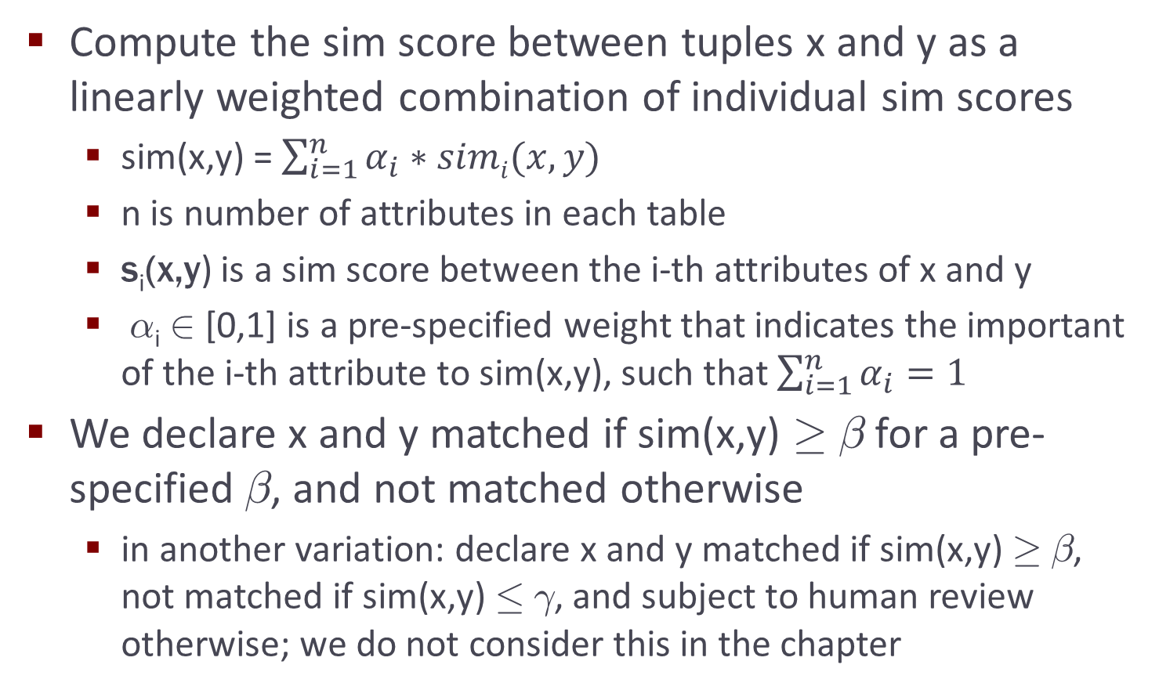
Linearly Weighted Combination Rules
Slide by Anhai Doan, Alon Halevy, Zachary Ives

Slide 38
Example
sim(x,y) = 0.3s_{name}(x,y) + 0.3s_{phone}(x,y) + 0.1s_{city}(x,y) + 0.3s_{state}(x,y)
s_{name}(x,y): based on Jaro-Winkler
s_{phone}(x,y): based on edit distance between x’s phone (after removing area code) and y’s phone
s_{city}(x,y): based on edit distance
s_{state}(x,y): based on exact match; yes ➔ 1, no ➔ 0
Slide by Anhai Doan, Alon Halevy, Zachary Ives

Slide 39
Pros and Cons
Pros
conceptually simple, easy to implement
can learn weights ∝_{i} from training data
Cons
an increase ± in the value of any s_{i} will cause a linear increase ∝_{i} * ± in the value of s
in certain scenarios this is not desirable, after a certain threshold an increase in s_{i} should count less (i.e., “diminishing returns” should kick in)
e.g., if s_{name}(x,y) is already 0.95 then the two names are already very closely match
so any increase in s_{name}(x,y) should contribute only minimally
Slide by Anhai Doan, Alon Halevy, Zachary Ives

Slide 40
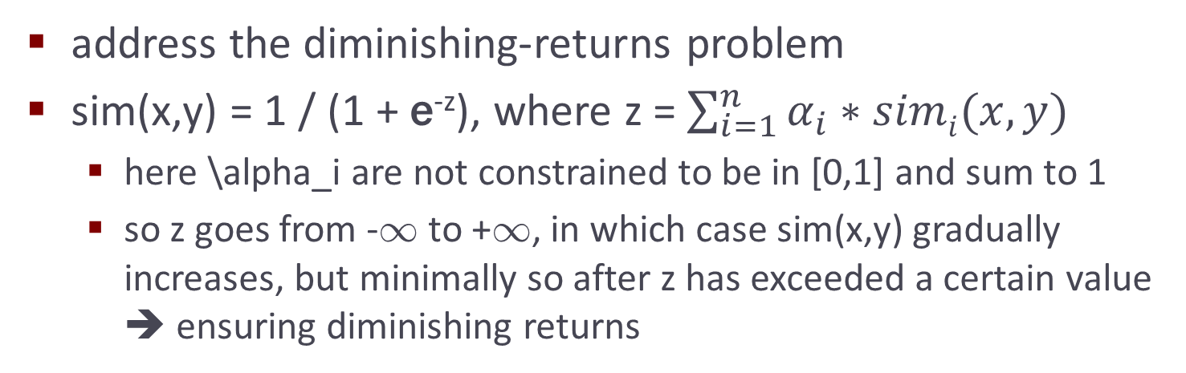
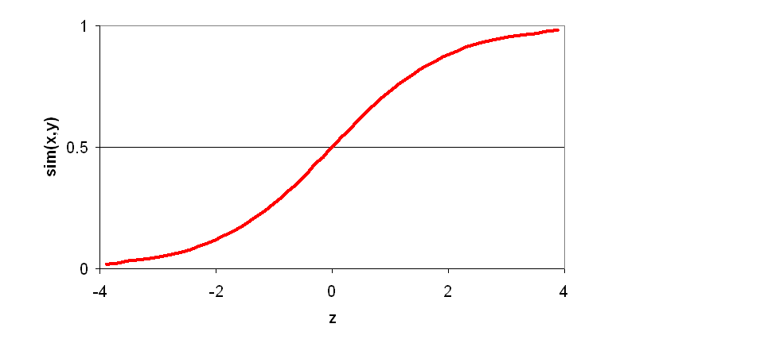
Logistic Regression Rules
Slide by Anhai Doan, Alon Halevy, Zachary Ives

Slide 41
Logistic Regression Rules
Are also very useful in situations where
there are many “signals” (e.g., 10-20) that can contribute to whether two tuples match
we don’t need all of these signals to “fire” in order to conclude that the tuples match
as long as a reasonable number of them fire, we have sufficient confidence
Logistic regression is a natural fit for such cases
Hence is quite popular as a first matching method to try
Slide by Anhai Doan, Alon Halevy, Zachary Ives

Slide 42
More Complex Rules
Appropriate when we want to encode more complex matching knowledge
e.g., two persons match if names match approximately and either phones match exactly or addresses match exactly
If s_{name}(x,y) < 0.8 then return “not matched”
Else if e_{phone}(x,y) = true then return “matched”
Else if e_{city}(x,y) = true and e_{state}(x,y) = true then return “matched”
Else return “not matched”
Slide by Anhai Doan, Alon Halevy, Zachary Ives

Slide 43
Pros and Cons of Rule-Based Approaches
Pros
easy to start, conceptually relatively easy to understand, implement, debug
typically run fast
can encode complex matching knowledge
Cons
can be labor intensive, it takes a lot of time to write good rules
can be difficult to set appropriate weights
in certain cases it is not even clear how to write rules
learning-based approaches address these issues
Slide by Anhai Doan, Alon Halevy, Zachary Ives

Slide 44
Outline
Blocking
Rule-based blocking
Learning-based blocking
Automatic blocking
Record Linkage
Rule-based matching
Learning-based matching
Automatic matching
slide by Craig Knoblock

Slide 45
Learning-based Matching
Here we consider supervised learning
learn a matching model M from training data, then apply M to match new tuple pairs
will consider unsupervised learning later
Learning a matching model M (the training phase)
start with training data: T = {(x₁,y₁,l₁), … (x_{n},y_{n},l_{n})}, where each (x_{i},y_{i}) is a tuple pair and l_{i} is a label: “yes” if x_{i} matches y_{i} and “no” otherwise
define a set of features f₁, …, f_{m}, each quantifying one aspect of the domain judged possibly relevant to matching the tuples
Slide by Anhai Doan, Alon Halevy, Zachary Ives

Slide 46
Learning-based Matching
Learning a matching model M (continued)
convert each training example (x_{i},y_{i},l_{i}) in T to a pair (<f₁(x_{i},y_{i}), …, f_{m}(x_{i},y_{i})>, c_{i})
v_{i} = <f₁(x_{i},y_{i}), …, f_{m}(x_{i},y_{i})> is a feature vector that encodes (x_{i},y_{i}) in terms of the features
c_{i} is an appropriately transformed version of label l_i (e.g., yes/no or 1/0, depending on what matching model we want to learn)
thus T is transformed into T’ = {(v₁,c₁), …, (v_{n},c_{n})}
apply a learning algorithm (e.g. decision trees, SVMs) to T’ to learn a matching model M
Slide by Anhai Doan, Alon Halevy, Zachary Ives

Slide 47
Learning-based Matching
Applying model M to match new tuple pairs
given pair (x,y), transform it into a feature vector
v = <f₁(x,y), …, f_{m}(x,y)>
apply M to v to predict whether x matches y
Slide by Anhai Doan, Alon Halevy, Zachary Ives

Slide 48
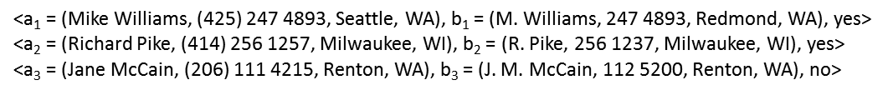
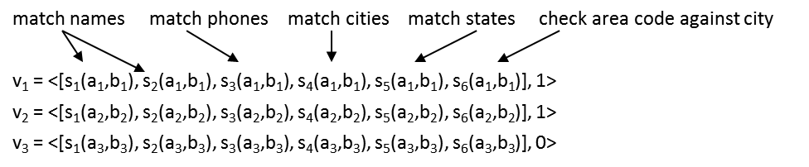
Example: Learning a Linearly Weighted Rule
s₁ and s₂ use Jaro-Winkler and edit distance
s₃ uses edit distance (ignoring area code of a)
s₄ and s₅ return 1 if exact match, 0 otherwise
s₆ encodes a heuristic constraint
Slide by Anhai Doan, Alon Halevy, Zachary Ives

Slide 49
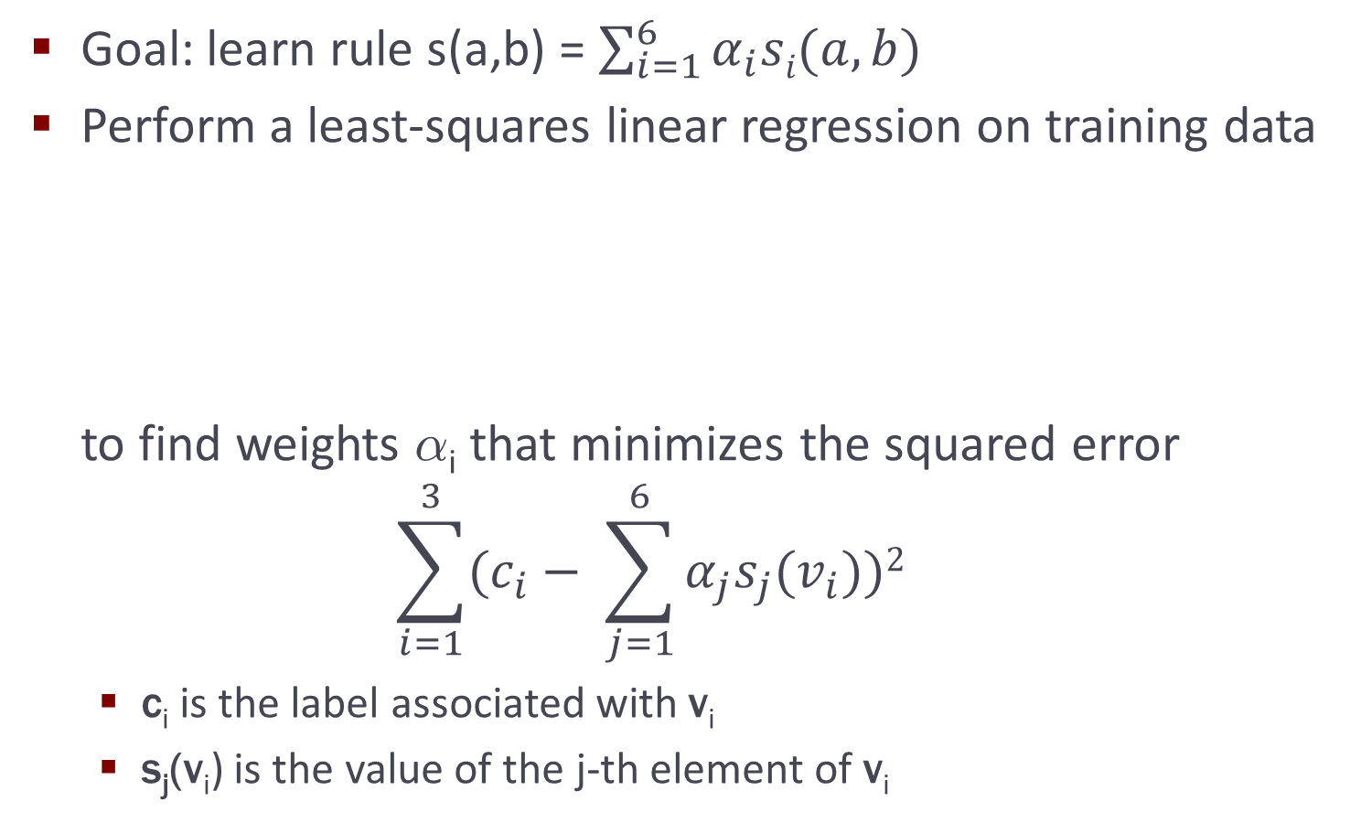
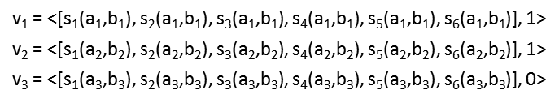
Example: Learning a Linearly Weighted Rule
Slide by Anhai Doan, Alon Halevy, Zachary Ives

Slide 50
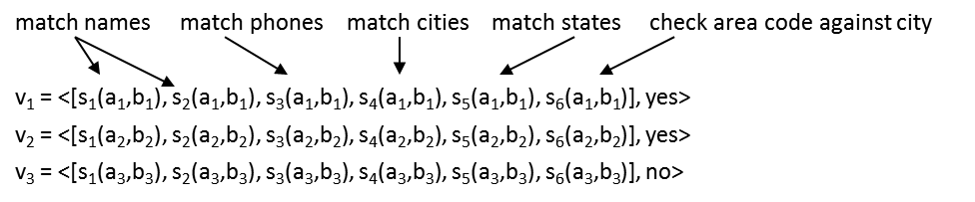
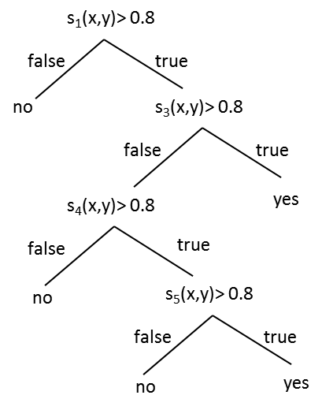
Example: Learning a Decision Tree
Now the labels are yes/no, not 1/0
Slide by Anhai Doan, Alon Halevy, Zachary Ives

Slide 51
The Pros and Cons of Learning-based Approach
Pros compared to rule-based approaches
in rule-based approaches must manually decide if a particular feature is useful ➔ labor intensive and limit the number of features we can consider
learning-based ones can automatically examine a large number of features
learning-based approaches can construct very complex “rules”
Cons
still require training examples, in many cases a large number of them, which can be hard to obtain
clustering addresses this problem
Slide by Anhai Doan, Alon Halevy, Zachary Ives

Slide 52
Outline
Blocking
Rule-based blocking
Learning-based blocking
Automatic blocking
Record Linkage
Rule-based matching
Learning-based matching
Automatic matching
slide by Craig Knoblock

Slide 53
Matching by Clustering
Many common clustering techniques have been used
agglomerative hierarchical clustering (AHC), k-means, graph-theoretic, …
here we focus on AHC, a simple yet very commonly used one
AHC
partitions a given set of tuples D into a set of clusters
all tuples in a cluster refer to the same real-world entity, tuples in different clusters refer to different entities
begins by putting each tuple in D into a single cluster
iteratively merges the two most similar clusters
stops when a desired number of clusters has been reached, or until the similarity between two closest clusters falls below a pre-specified threshold
Slide by Anhai Doan, Alon Halevy, Zachary Ives

Slide 54
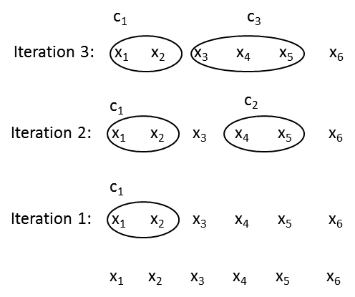
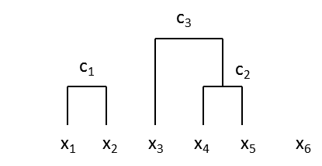
Example
sim(x,y) = 0.3s_{name}(x,y) + 0.3s_{phone}(x,y) + 0.1s_{city}(x,y) + 0.3s_{state}(x,y)
Slide by Anhai Doan, Alon Halevy, Zachary Ives

Slide 55
Computing a Similarity Score between Two Clusters
Let c and d be two clusters (with elements: x_{i}∊ c, y_{j}∊ d)
Single link: s(c,d) = min_{xi,yj} sim(x_{i}, y_{j})
Complete link: s(c,d) = max_{xi,yj} sim(x_{i}, y_{j})
Average link: s(c,d) = [∑_{xi,yj} sim(x_{i}, y_{j})] / [# of (x_{i},y_{j}) pairs]
Canonical tuple
create a canonical tuple that represents each cluster
sim between c and d is the sim between their canonical tuples
canonical tuple is created from attribute values of the tuples
e.g., “Mike Williams” and “M. J. Williams” ➔ “Mike J. Williams”
(425) 247 4893 and 247 4893 ➔ (425) 247 4893
Slide from Anhai Doan, Alon Halevy, Zachary Ives

Slide 56
Key Ideas underlying the Clustering Approach
View matching tuples as the problem of constructing entities (i.e., clusters)
The process is iterative
leverage what we have known so far to build “better” entities
In each iteration merge all matching tuples within a cluster to build an “entity profile”, then use it to match other tuples
merging then exploiting the merged information to help matching
Slide by Anhai Doan, Alon Halevy, Zachary Ives

Slide 57
Summary
Blocking Schemes
Need to scale to large datasets
Learning approaches better than non-experts ad-hoc rules and comparable to domain expert’s rules
Record linkage is a critical problem in data integration
Huge amount of work in academia and industry
Rule-based matching
Learning- based matching
Matching by clustering
slide by Craig Knoblock

